Slide 1
Does increasing spending lead to more wins compared to the previous season in the mlb
Anthony brennan
4/24/2017

Slide 2

Research question
Does increasing payroll lead to an increase in wins in the MLB?
Often teams will drastically increase payroll to sign bigger name players in an attempt to win more games
Ex Los Angeles Dodgers payroll 2011: $95 million 2012: $216 million
Baseball is the only US sports league without a salary cap
Moneyball changed the way baseball front offices view talent and how much to spend
Testing to see if the increasing payroll strategy still works in the post Moneyball era

Slide 3
Previous Research
Can Money Buy Success?: A Study of Team Payroll and Performance in the MLB; Shahriar Hasan
An Analysis of the Impact of Team Payroll on Regular Season and Postseason Success in Major League Baseball; Noah L. Schwartz and Jason M. Zarrow
Both studied the effects of total payroll on regular season percentage, and, in the second study, postseason success
Both concluded there is a positive relationship between payroll and regular season wins
The second study concluded that there is no statistically significant relationship between payroll and post season success (the late 90’s Yankees being a historical anomaly)

Slide 4
Data
The data is for the 2004-2015 MLB seasons (2004 being the first full season after Moneyball was released)
Data from 2003 is included to calculate the change in wins, payroll, and attendance for the 2004 season.
The data includes wins (baseball_reference.com); payroll and attendance (thebaseballcube.com)
The data sources are combined so that the data matches both the team name and year

Slide 5
Variables
Independent: Wins_change – Difference in wins between two seasons
Dependent: Payroll – Total payroll for the season;
Payroll_change – Difference in payroll between two seasons;
Attendance – Total attendance for the season;
Attendance_change – Difference in attendance between two seasons;
Wins_minus – Total wins from the previous season;
AvgPay_change - Difference in the average MLB payroll between two seasons

Slide 6
Econometric model
Wins_change = B₀ + B₁*Payroll_change + B₂*Payroll + B₃*Attendance_change + B₄*Attendance + B₅*Wins_minus + B₆*AvgPay_change
Wins_change = B₀ + B₁*Payroll_change + B₂*Payroll + B₃*Wins_minus + B₄*AvgPay_change

Slide 7
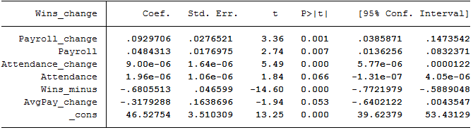
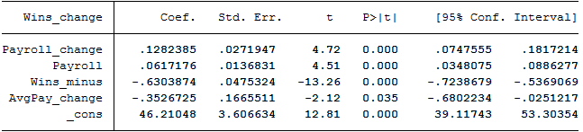
Findings
Model 1 (with Attendance variables)
Model 2 (without Attendance variables)

Slide 8
Next Steps and conclusion
Decide if it is necessary to use log on any of the variables, adding a squared variable, including a time trend, etc.
If I were to continue, I could test to see if there is difference in the effect of raising payroll between different eras of baseball
The overall goal of the research question is to see if increasing payroll is still a good strategy for MLB front offices to use in an attempt to increase their total wins from the previous season

